Slide 1
Properties of
Regular Languages
Costas Busch - LSU

Slide 2




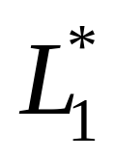
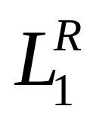


For regular languages and
we will prove that:
Union:
Concatenation:
Are regular
Languages
Star:
Reversal:
Complement:
Intersection:
Costas Busch - LSU

Slide 3
We say Regular languages are closed under
Union:
Concatenation:
Star:
Reversal:
Complement:
Intersection:
Costas Busch - LSU

Slide 4



A useful transformation: use one accept state
NFA
2 accept states
Equivalent
NFA
1 accept state
Costas Busch - LSU

Slide 5
In General
NFA
Equivalent NFA
Single
accepting
state
Costas Busch - LSU

Slide 6
Extreme case
NFA without accepting state
Add an accepting state
without transitions
Costas Busch - LSU

Slide 7
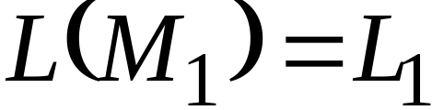
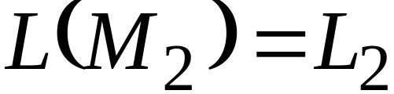


Take two languages
Regular language
Regular language
NFA
NFA
Single accepting state
Single accepting state
Costas Busch - LSU

Slide 8

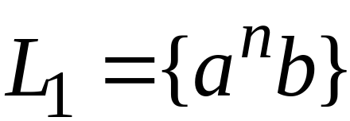
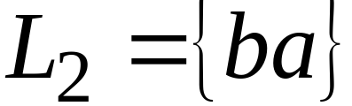
Example
Costas Busch - LSU

Slide 9
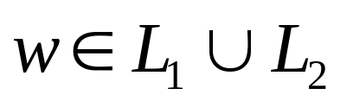
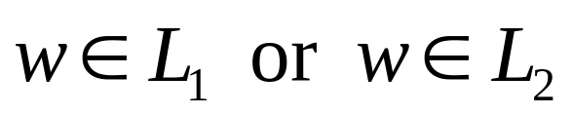
Union
NFA for
Costas Busch - LSU

Slide 10
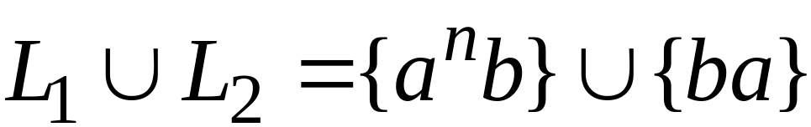
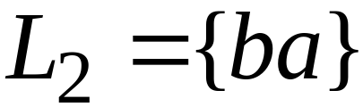
Example
NFA for
Costas Busch - LSU

Slide 11
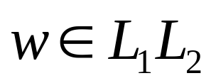
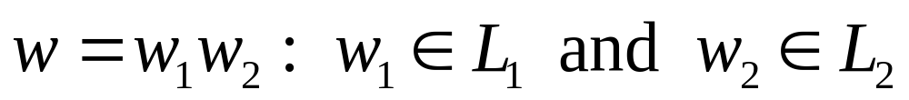
Concatenation
NFA for
change to
regular state
Costas Busch - LSU

Slide 12
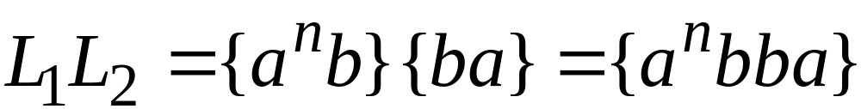
Example
NFA for
Costas Busch - LSU

Slide 13
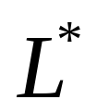


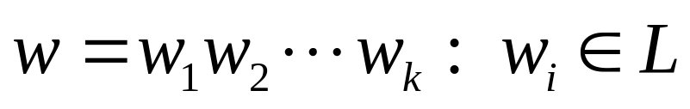
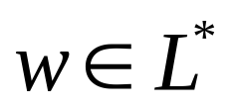

Star Operation
NFA for
or
Costas Busch - LSU

Slide 14
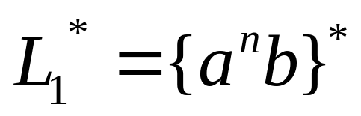

Example
NFA for
Costas Busch - LSU

Slide 15
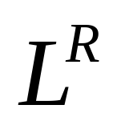




Reverse
NFA for
1. Reverse all transitions
2. Make the initial state accept state
and the accept state initial state
Costas Busch - LSU

Slide 16
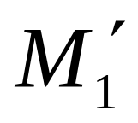
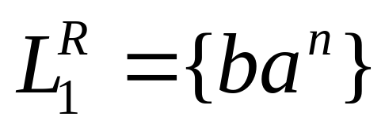
Example
Costas Busch - LSU

Slide 17

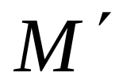
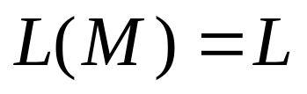
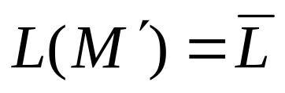

Complement
1. Take the DFA that accepts
2. Make accept states regular
and vice-versa
Costas Busch - LSU

Slide 18

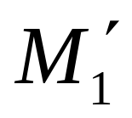
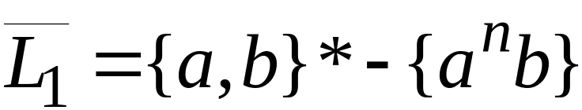
Example
Costas Busch - LSU

Slide 19
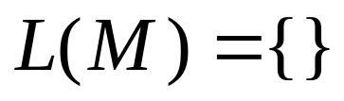
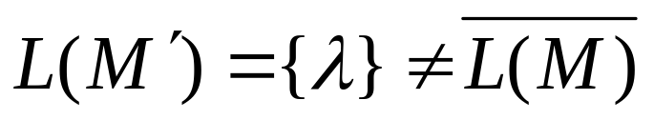
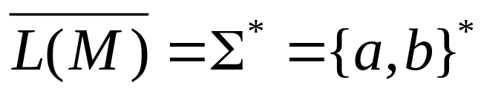
NFAs cannot be used for complement
Make accept states regular
and vice-versa
NFA
NFA
it is not the
complement
Costas Busch - LSU

Slide 20
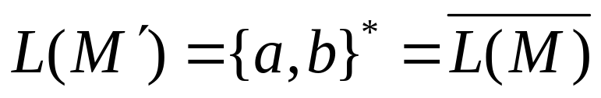
Same example with DFAs
Make accept states regular
and vice-versa
DFA
DFA
it is the
complement
Costas Busch - LSU

Slide 21
Intersection
regular
We show
regular
regular
Costas Busch - LSU

Slide 22




DeMorgan’s Law:
regular, regular
regular, regular
regular
regular
regular
Costas Busch - LSU

Slide 23
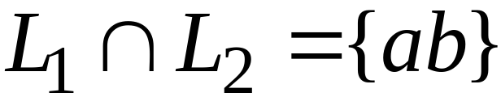
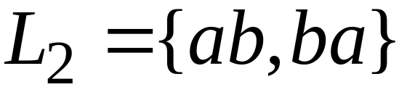
Example
regular
regular
regular
Costas Busch - LSU

Slide 24

Another Proof for Intersection Closure
Machine
Machine
DFA
for
DFA
for
Construct a new DFA that accepts
simulates in parallel and
Costas Busch - LSU

Slide 25

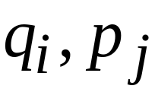
States in
State in
State in
Costas Busch - LSU

Slide 26




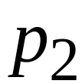
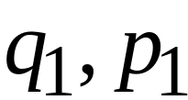
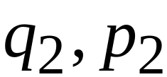
DFA
DFA
transition
transition
DFA
New transition
Costas Busch - LSU

Slide 27


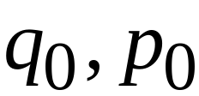
DFA
DFA
initial state
initial state
DFA
New initial state
Costas Busch - LSU

Slide 28



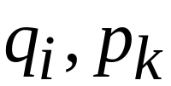
DFA
DFA
accept state
accept states
DFA
New accept states
Both constituents must be accepting states
Costas Busch - LSU

Slide 29

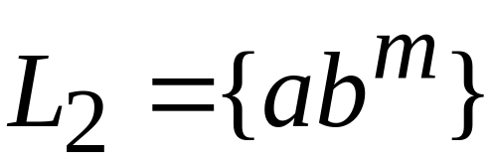








Example:
Costas Busch - LSU

Slide 30

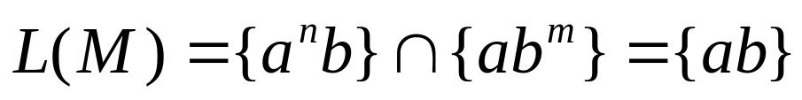







DFA for intersection
Costas Busch - LSU

Slide 31
Construction procedure for intersection
1. Build Initial State
2. For each new state and for each symbol
add transition to either an existing state
or create a new state and point to it
3. Repeat step 3 until no new states
are added
4. Designate accept states
Costas Busch - LSU

Slide 32
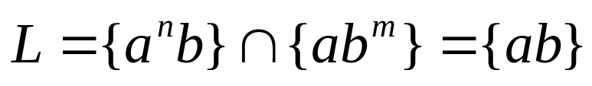
Automaton for intersection
initial state
Costas Busch - LSU

Slide 33






Automaton for intersection
add transition and new state
for symbol a
Costas Busch - LSU

Slide 34





Automaton for intersection
add transition and new state
for symbol b
Costas Busch - LSU

Slide 35
Automaton for intersection
Repeat until no new states can be added
Costas Busch - LSU

Slide 36




Automaton for intersection
accept state for
accept state for
add Accept state
Costas Busch - LSU

Slide 37


Intersection DFA :
simulates in parallel and
accepts string
if and only if:
accepts string
and accepts string
Costas Busch - LSU

